Slide 1

NeuroDOT 2.2.0 Base
Appendix - AC Sample Results

Slide 2
Introduction
This appendix is intended to provide a simple "gold standard" against which advanced users can compare their own results when using NeuroDOT 2.2.0 Base.
This will be presented as a series of visualization screenshots.

Slide 3
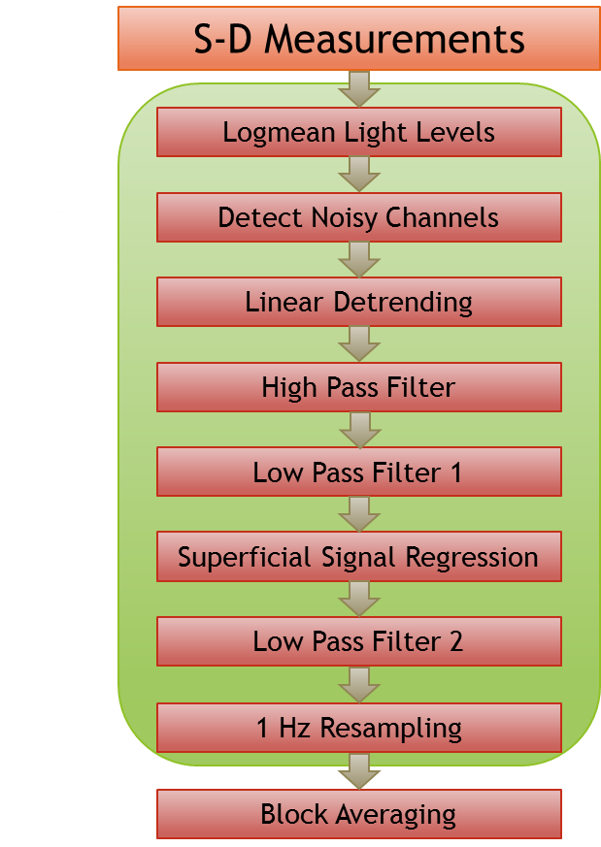
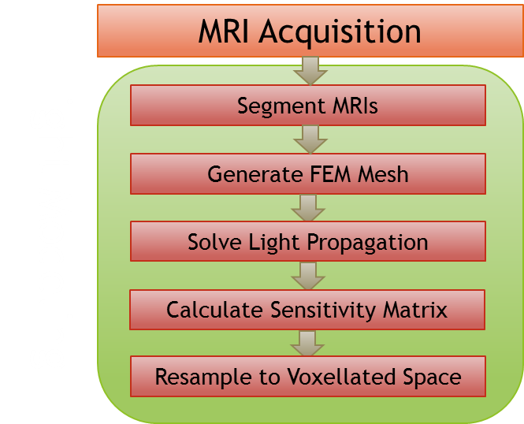
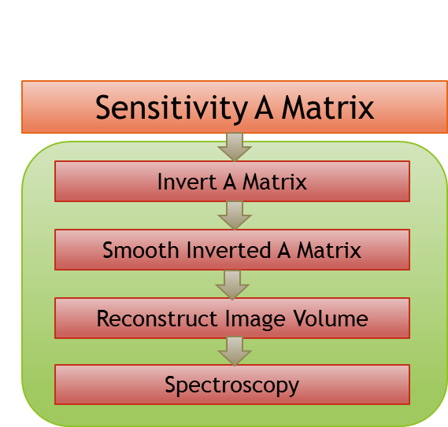
NeuroDOT 2 Overview Flowchart

Slide 4
Preprocessing Pipeline Flowchart
S-D Measurements
Logmean Light Levels
Detect Noisy Channels
Linear Detrending
High Pass Filter
Low Pass Filter 1
Superficial Signal Regression
Low Pass Filter 2
1 Hz Resampling
Block Averaging

Slide 5
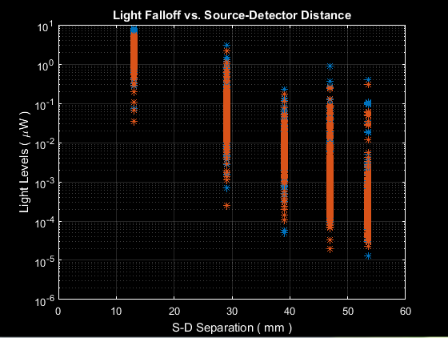
S-D Measurements

Slide 6
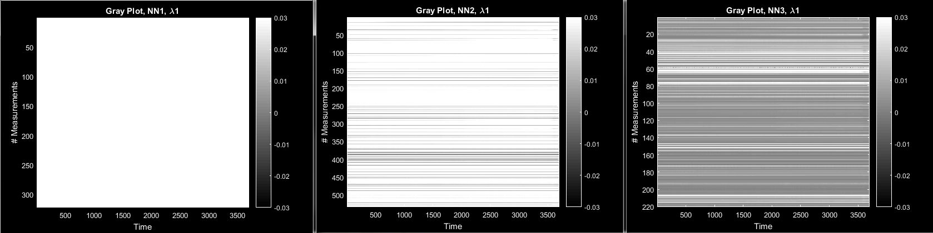
S-D Measurements

Slide 7
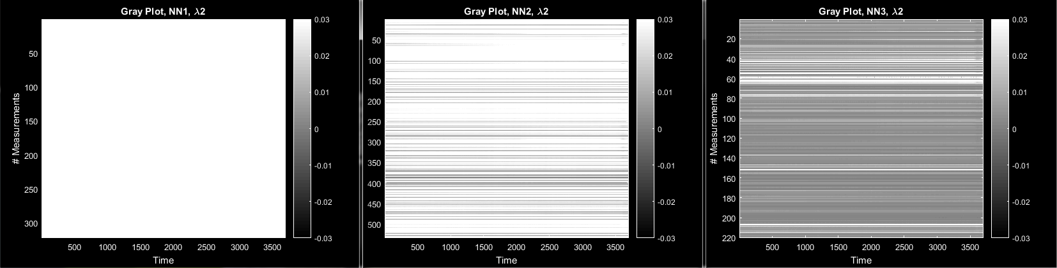
S-D Measurements

Slide 8
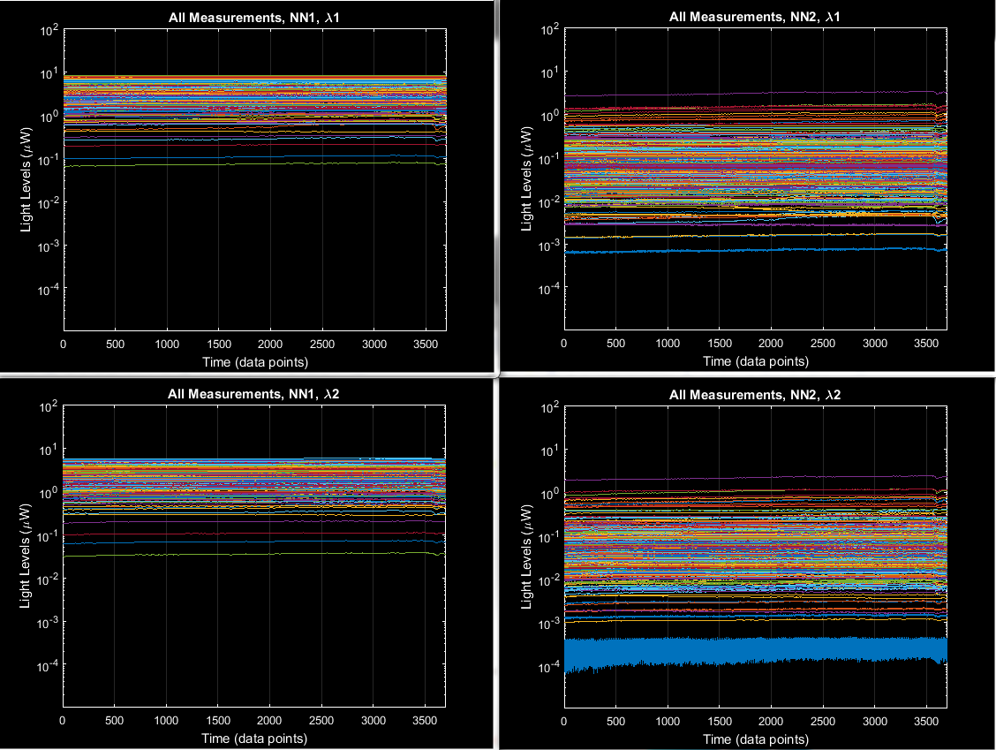
S-D Measurements

Slide 9
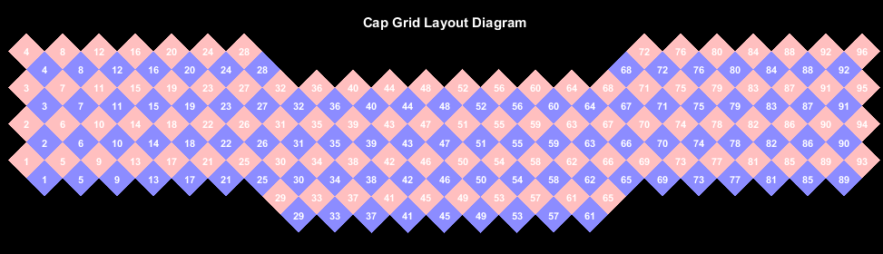
S-D Measurements

Slide 10
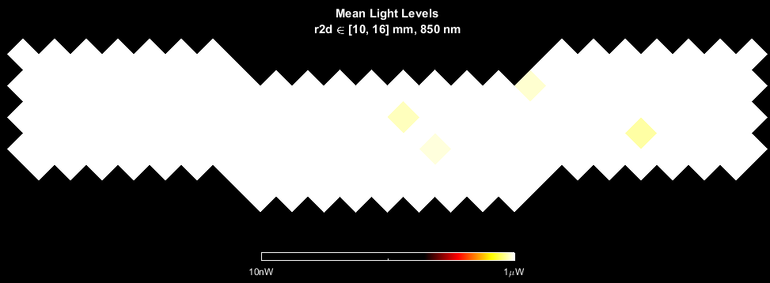
S-D Measurements

Slide 11
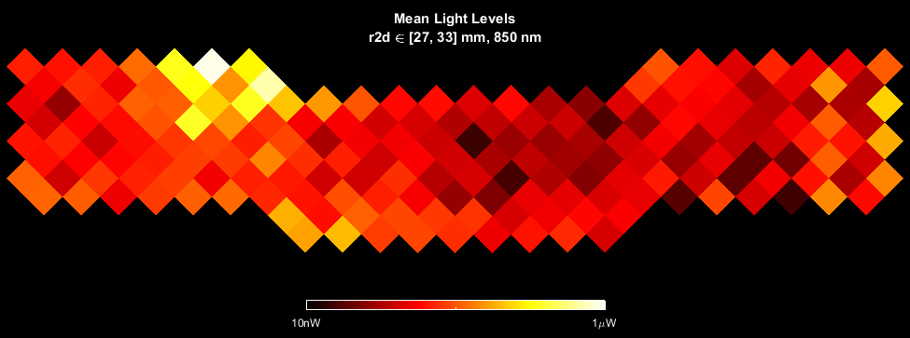
S-D Measurements

Slide 12
Preprocessing Pipeline Flowchart
S-D Measurements
Logmean Light Levels
Detect Noisy Channels
Linear Detrending
High Pass Filter
Low Pass Filter 1
Superficial Signal Regression
Low Pass Filter 2
1 Hz Resampling
Block Averaging

Slide 13
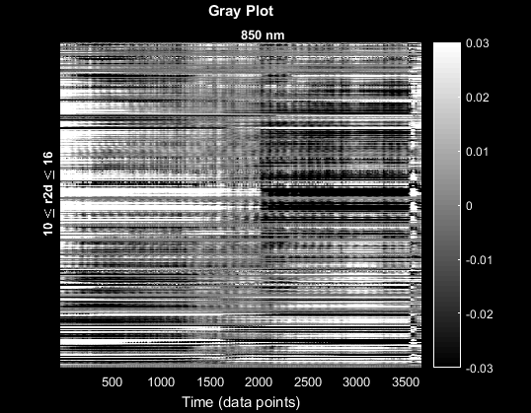
Logmean

Slide 14
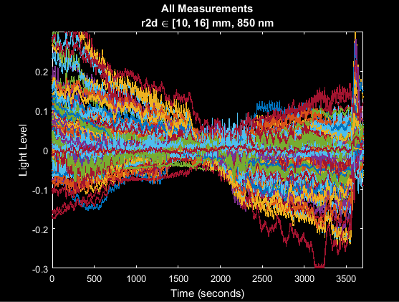
Logmean

Slide 15
Preprocessing Pipeline Flowchart
S-D Measurements
Logmean Light Levels
Detect Noisy Channels
Linear Detrending
High Pass Filter
Low Pass Filter 1
Superficial Signal Regression
Low Pass Filter 2
1 Hz Resampling
Block Averaging

Slide 16
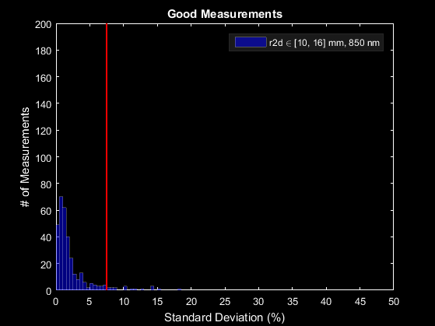
Good Measurements

Slide 17
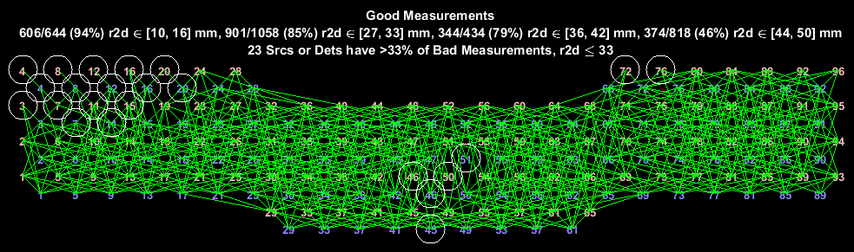
Good Measurements

Slide 18
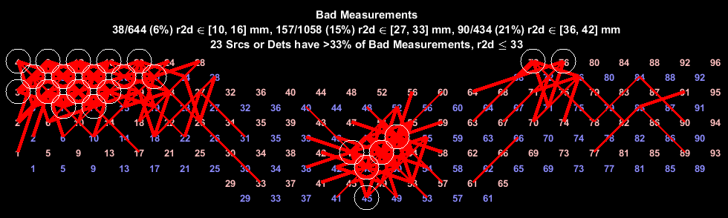
Good Measurements

Slide 19
Preprocessing Pipeline Flowchart
S-D Measurements
Logmean Light Levels
Detect Noisy Channels
Linear Detrending
High Pass Filter
Low Pass Filter 1
Superficial Signal Regression
Low Pass Filter 2
1 Hz Resampling
Block Averaging

Slide 20
Preprocessing Pipeline Flowchart
S-D Measurements
Logmean Light Levels
Detect Noisy Channels
Linear Detrending
High Pass Filter
Low Pass Filter 1
Superficial Signal Regression
Low Pass Filter 2
1 Hz Resampling
Block Averaging

Slide 21
Preprocessing Pipeline Flowchart
S-D Measurements
Logmean Light Levels
Detect Noisy Channels
Linear Detrending
High Pass Filter
Low Pass Filter 1
Superficial Signal Regression
Low Pass Filter 2
1 Hz Resampling
Block Averaging

Slide 22
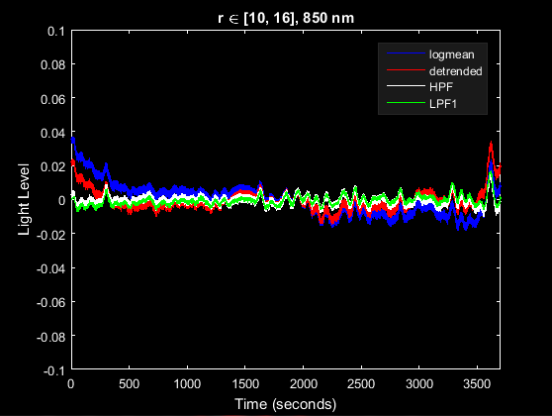
LPF1

Slide 23
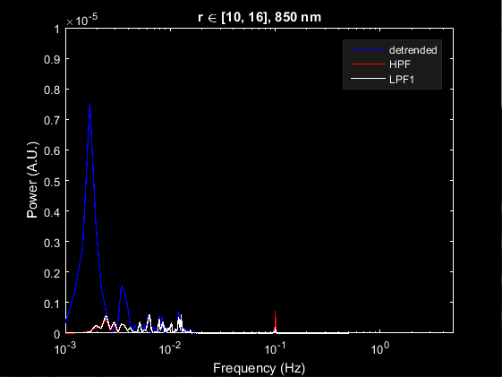
LPF1

Slide 24
Preprocessing Pipeline Flowchart
S-D Measurements
Logmean Light Levels
Detect Noisy Channels
Linear Detrending
High Pass Filter
Low Pass Filter 1
Superficial Signal Regression
Low Pass Filter 2
1 Hz Resampling
Block Averaging

Slide 25
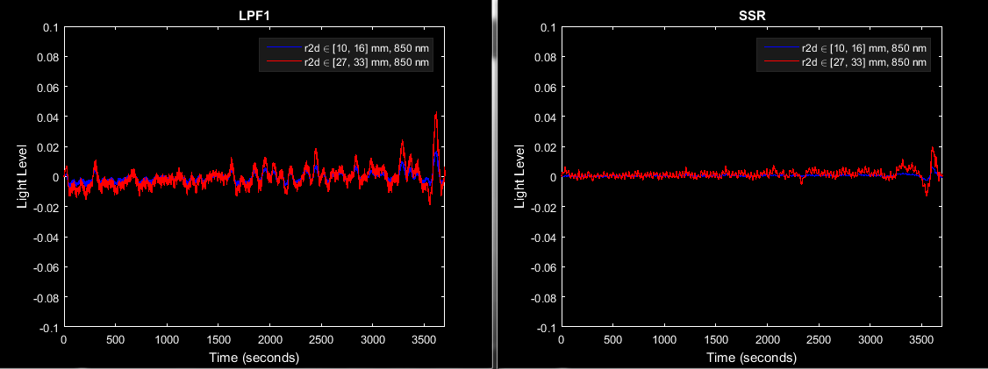
SSR

Slide 26
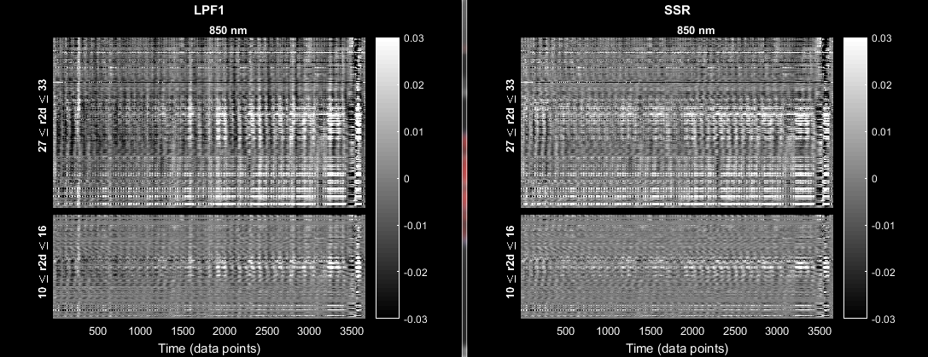
SSR

Slide 27
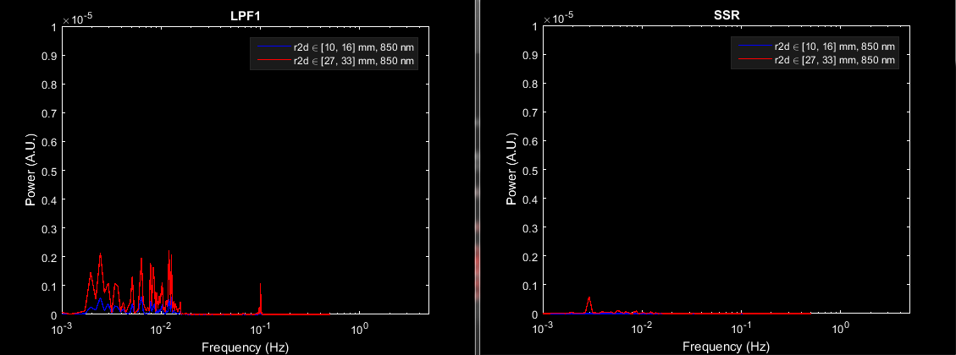
SSR

Slide 28
Preprocessing Pipeline Flowchart
S-D Measurements
Logmean Light Levels
Detect Noisy Channels
Linear Detrending
High Pass Filter
Low Pass Filter 1
Superficial Signal Regression
Low Pass Filter 2
1 Hz Resampling
Block Averaging

Slide 29
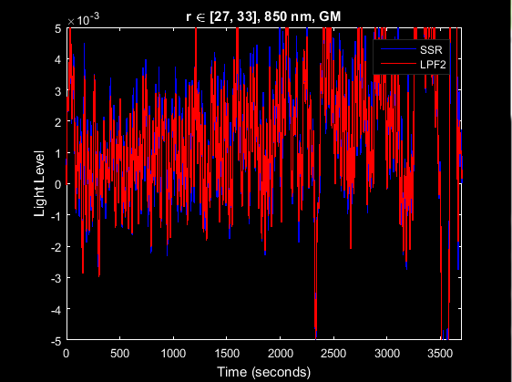
LPF2

Slide 30
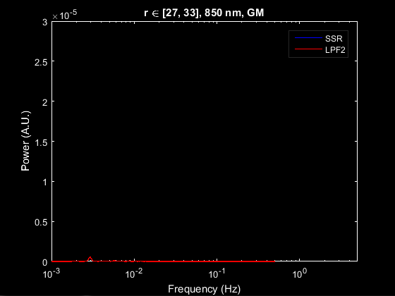
LPF2

Slide 31
Preprocessing Pipeline Flowchart
S-D Measurements
Logmean Light Levels
Detect Noisy Channels
Linear Detrending
High Pass Filter
Low Pass Filter 1
Superficial Signal Regression
Low Pass Filter 2
1 Hz Resampling
Block Averaging

Slide 32
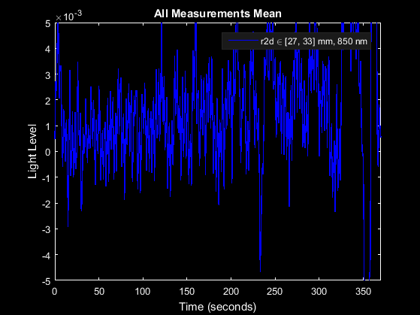
1 Hz Resampling

Slide 33
Preprocessing Pipeline Flowchart
S-D Measurements
Logmean Light Levels
Detect Noisy Channels
Linear Detrending
High Pass Filter
Low Pass Filter 1
Superficial Signal Regression
Low Pass Filter 2
1 Hz Resampling
Block Averaging

Slide 34
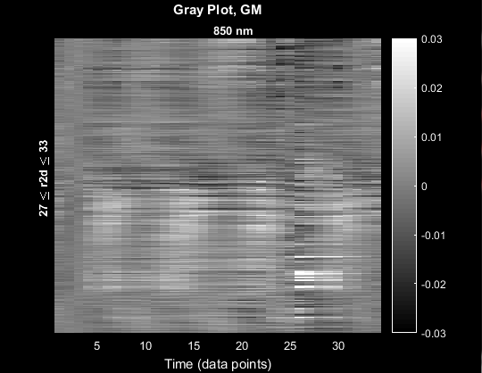
Block Averaging

Slide 35
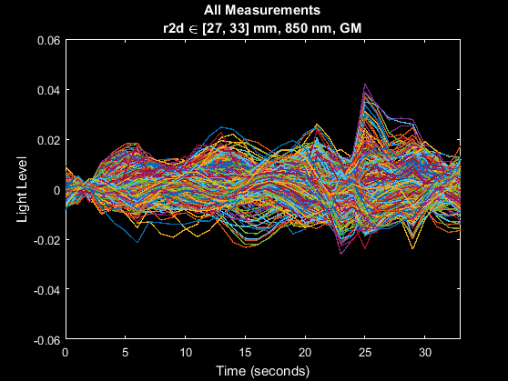
Block Averaging

Slide 36
Preprocessing Pipeline Flowchart
S-D Measurements
Logmean Light Levels
Detect Noisy Channels
Linear Detrending
High Pass Filter
Low Pass Filter 1
Superficial Signal Regression
Low Pass Filter 2
1 Hz Resampling
Block Averaging

Slide 37
That’s It (Again)
For further questions or more information, please consult the NeuroDOT 2.2.0 Base User Manual and the various Appendices.
NeuroDOT 2 Support Team:
Adam Eggebrecht (aeggebre@wustl.edu)
David Muccigrosso (muccigrosso.david@wustl.edu)

